Slide 1
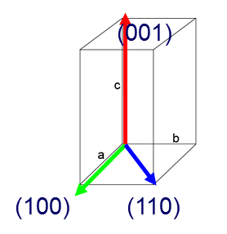
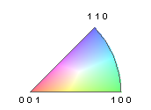
Grain/GB structure in a Bi2212 filament
2-dimentional confinement by the filament structure forces Bi2212 to grow along the wire direction.
Thin but large grain shape presumably due to slow cooling.
Quasi-textured regions alternate with untextured regions.
10 µm

Slide 2
10 µm

Slide 3
10 µm

Slide 4
10 µm

Slide 5
10 µm

Slide 6
10 µm

Slide 7
10 µm

Slide 8
10 µm

Slide 9
10 µm

Slide 10
10 µm

Slide 11
10 µm

Slide 12
10 µm

Slide 13
10 µm

Slide 14
10 µm

Slide 15
10 µm

Slide 16
10 µm

Slide 17
10 µm

Slide 18
10 µm

Slide 19
10 µm

Slide 20
Invited Talk by Fumitake Kametani: Where does the current flow in macroscopically untextured Bi2212 round wires?
F. Kametani, J. Jiang, N. Craig, M. R. Matras, E. E. Hellstrom and D. C. Larbalestier
Applied Superconductivity Center,
National High Magnetic Field Laboratory, Florida State University
Tallahassee FL 32310
Bi2212 round wires provided by OST
10 µm
*Animation made by P. J. Lee

